Slide 1
Optical Illusions

Slide 2
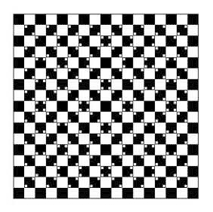

Slide 3
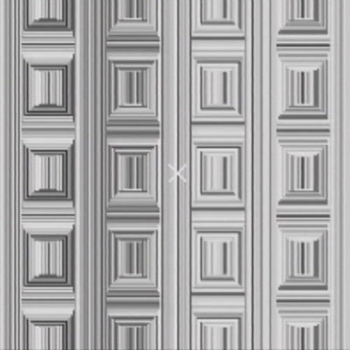

Slide 4
